Slide 1
PROGRAMMING FOR PROBLEM SOLVING USING C
UNIT 2
By
Dr. G SANTOSH KUMAR
ASSISTANT PROFESSOR
DEPARTMENT OF CIVIL ENGINEERING
GAYATRI VIDYA PARISHAD COLLEGE OF ENGINEERING (A)

Slide 2
SYLLABUS
OVERVIEW OF C: Basic Data types, Modifying the Basic DataTypes, Identifier-Names, Variables, Type Qualifiers, Constants, Operators, Expressions, Selection, Iteration and Jump Statements.
FUNCTIONS: Designing Structured Programs, Functions Basics, Standard Library Functions, User Defined Functions, Categories of Functions, Parameter Passing Techniques, Scope, Scope Rules, Storage Classes and Type Qualifiers, Recursion: Recursive Functions, Preprocessor Directives.

Slide 3
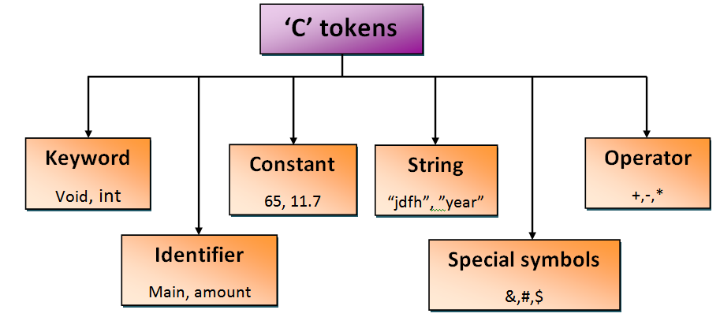
Tokens of C
Token is a small individual unit used to make a complete program. There are 6 different tokens are used in ‘C’.
Keyword
Identifier
Constant
String
Special symbols
operator

Slide 4
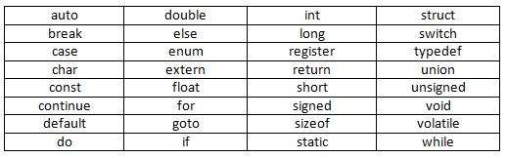
Token - keywords
Keywords are predefined or reserved words in C compiler, where each keyword having its own functionality and importance.
The keywords cannot be used as a variable names and C language supports 32 keywords.
All the keywords in C are lowercase in nature.

Slide 5
Token - Identifiers
Identifiers are used for naming “variables”, “functions”, “arrays”, “structures”, etc.
Identifiers are “user defined words” which can be composed of uppercase letters, lowercase letters, underscore, or digits, but the starting letter should be either underscore or an alphabet.
Example for valid identifiers: Example for invalid identifiers:
float total; float 2sum;
int sum; int int;
int _m _; float m+n;
float sum_1; float char;

Slide 6
Rules for constructing C identifiers
The first character of an identifier should be either an alphabet or an underscore but not digit.
In identifiers, both uppercase and lowercase letters are distinct. Therefore, we can say that identifiers are case sensitive.
Commas or blank spaces cannot be specified within an identifier.
Keywords cannot be represented as an identifier.
The length of the identifiers should not be more than 31 characters.
Identifiers should be written in such a way that it is meaningful, short, and easy to read.

Slide 7
Differences between Keyword and Identifier
Keyword | Identifier
Keyword is a pre-defined word. | The identifier is a user-defined word
It must be written in a lowercase letter. | It can be written in both lowercase and uppercase letters.
Its meaning is pre-defined in the c compiler. | Its meaning is not defined in the c compiler.
It is a combination of alphabetical characters. | It is a combination of alphanumeric characters.
It does not contain the underscore character. | It can contain the underscore character.

Slide 8
Tokens - constants
A constant is a value assigned to the particular variable which will remain the same throughout the program.
There are two different ways to define constants in c programming:
1. using const keyword
2. using #define pre-processor
Syntax:
const data_type variable_name=value; (or) #define PI 3.14;
Example:
const float PI = 3.142;
const int a=10;

Slide 9
Using const keyword
#include<stdio.h>
#include<conio.h>
void main()
{
const float PI=3.14;
printf("The value of PI is: %f", PI);
getch();
}
#include<stdio.h>
#include<conio.h>
void main()
{
const float PI=3.14;
PI=4.5;
printf("The value of PI is: %f", PI);
getch();
}
Output:
The value of PI is: 3.140000
Output:
Compile Time Error: Cannot modify a const object

Slide 10
Types of constants
constant | Example
Integer constant | 10,11,34 etc.
Floating point constant | 45.6, 67.8,11.2 etc.
Octal constant | 011, 088,022 etc
Hexadecimal constant | 0x1a, 0x4b, 0x6b etc
Character constant | ‘a’, ‘b’, ‘c’ etc
String constant | “java”, “c++”, “.net” etc.

Slide 11
Rules for constructing C constants
1. Integer constants:
An integer constant must have at least one digit.
It must not have a decimal point.
It can either be positive or negative.
No commas or blanks are allowed within an integer constant.
If no sign precedes an integer constant, it is assumed to be positive.
The allowable range for integer constants is -32768 to 32767.

Slide 12
Rules for constructing C constants
2. Floating point constants:
A floating point constant must have at least one digit .
It must have a decimal point
It could be either positive or negative
If no sign precedes an floating point constant, it is assumed to be positive.
No commas or blanks are allowed within a real constant.

Slide 13
Rules for constructing C constants
3. Character and string constants:
A character constant is a single alphabet, a single digit or a single special symbol enclosed within single quotes.
The maximum length of a character constant is 1 character.
String constants are enclosed within double quotes.

Slide 14
Rules for constructing C constants
4. Backslash and string constants:
There are some characters which have special meaning in C language.
They should be preceded by backslash symbol to make use of special function of them.
Given below is the list of special characters and their purpose.
\b - backspace \n- new line \t – horizontal tab
\” – double quote \’ – single quote \\ - backslash
\v – vertical tab \? – question mark

Slide 15
How to use constants in C program
#include<stdio.h>
#include<conio.h>
#define letter 'A'
#define backslash_char '\?'
void main()
{
const int height = 100;
const float number = 3.14;
printf("value of height :%d \n", height );
printf("value of number : %f \n", number );
printf("value of letter : %c \n", letter );
printf("value of backslash_char : %c \n", backslash_char);
getch();
}
Output:
value of height : 100
value of number : 3.140000
value of letter :A
value of backslash_char : ?

Slide 16
Tokens - strings
String are nothing but an array of characters ended with a null character (‘\0’).
This null character indicates the end of the string. Strings are always enclosed with double quotes whereas, a character is enclosed in single quotes in C.
Example:
char a[10] = “welcome”; // compiler allocates 10 bytes of memory
char a[]= “welcome to C”; //compiler allocates memory at run time
char a[6]={‘w’,’e’,’l’,’c’,’o’,’m’,’e’,’\0’}; //string is represented in characters

Slide 17
Token – special symbols
Special symbols are used in C and they have special meaning which cannot be used for another purpose.
Square brackets [ ]: represents the single and multidimensional subscripts.
Simple brackets ( ): used in function declaration and function calling.
Curly braces { } : used in the opening and closing of the code as well as in loops.
Comma (,): used for separating for more than one statement.
Pre-processor (#): basically denotes that we are using the header file.
Asterisk (*): used to represent pointers and operator for multiplication
Period (.): used to access a member of a structure or a union.

Slide 18
Tokens – operators
An operator is simply a symbol that is used to perform operations. There are following types of operators to perform different types of operations in C language:
1) Arithmetic Operators 2) Relational Operators 3) Logical Operators
4) Bitwise Operators 5) Conditional Operators 6) Assignment Operator
7) Special Operator
The “precedence” of operator specifies that which operator will be evaluated first and next. The “associativity” specifies the operator direction to be evaluated; it may be left to right or right to left. ( ), ^, /, *, +, -, =

Slide 19
1. Arithmetic Operators
Operator | Description | Syntax | Example
+ | adds two operands | operand + operand | A + B
_ | subtract second operands from first | operand – operand | A – B
* | multiply two operand | operand * operand | A * B
/ | divide numerator by denominator | operand / operand | A / B
% | remainder of division | operand % operand | A % B
++ | Increment operator increases integer value by one | operand + + | A + +
_ _ | Decrement operator decreases integer value by one | operand - - | A - -

Slide 20
2.Relational operators
Operator | Description
== | Check if two operand are equal
!= | Check if two operand are not equal.
> | Check if operand on the left is greater than operand on the right
< | Check operand on the left is smaller than right operand
>= | check left operand is greater than or equal to right operand
<= | Check if operand on left is smaller than or equal to right operand

Slide 21
3. Logical operators
Operator | Description | Example
&& | Logical AND | (a && b) is false
|| | Logical OR | (a || b) is true
! | Logical NOT | (!a) is false

Slide 22
4. Bitwise operator
Operator | Description
& | Bitwise AND
| | Bitwise OR
^ | Bitwise exclusive OR
<< | left shift
>> | right shift

Slide 23
Now lets see truth table for bitwise &, | and ^
A | B | A&B | A | B | A^B
0 | 0 | 0 | 0 | 0
0 | 1 | 0 | 1 | 1
1 | 0 | 0 | 1 | 1
1 | 1 | 1 | 1 | 0

Slide 24
5. Assignment operators
Operator | Description | Example
= | assigns values from right side operands to left side operand | a=b
+= | adds right operand to the left operand and assign the result to left | a+=b is same as a=a + b
-= | subtracts right operand from the left operand and assign the result to left operand | =b is same as a=a-b
*= | multiply left operand with the right operand and assign the result to left operand | a*=b is same as a=a*b
/= | divides left operand with the right operand and assign the result to left operand | a/=b is same as a=a / b
%= | calculate modulus using two operands and assign the result to left operand | a%=b is same as a=a % b

Slide 25
6. Conditional operators
The conditional operators in C language are known by two more names
Ternary Operator
? : Operator
It is actually the if condition that we use in C language decision making, but using conditional operator, we turn the if condition statement into a short and simple operator.
The syntax of a conditional operator is :
(condition) ? expression 1: expression 2

Slide 26
7. Special operators
Operator | Description | Example
Sizeof | Returns the size of an variable | sizeof(x) return size of the variable x
& | Returns the address of an variable | &x ; return address of the variable x
* | Pointer to a variable | *x ; will be pointer to a variable x

Slide 27
Data types in C

Slide 28
What is a Data type?
“Data type” is a representation of a data. Clearly we can say that how much memory is required to allocate and what type of data is allowed to store in it.
C language has some predefined set of data types to handle various kinds of data that we can use in our program. These data types have different storage capacities.
Data types are classified into three types
Primitive data type
Derived data type
User defined data type

Slide 29
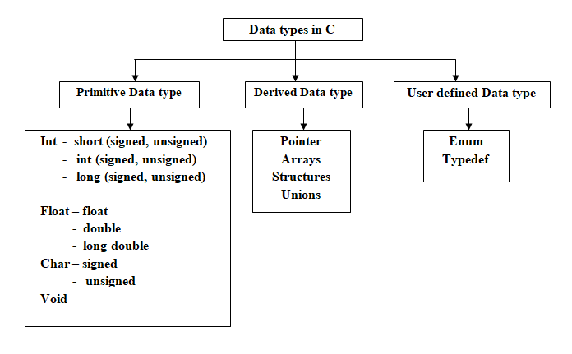
Classification of Data types

Slide 30
Primitive data types
Type | Size(bytes) | Range
int or signed int | 2 or 4 bytes | -32,768 to 32,767 (or) -2,147,483,648 to 2,147,483,647
Unsigned int | 2 or 4 bytes | 0 to 65,535 (or) 0 to 4,294,967,295
Signed short | 2 bytes | -32,768 to 32,767
Unsigned short | 2 bytes | 0 to 65,535
Signed long | 4 bytes | -2,147,483,648 to 2,147,483,647
Unsigned long | 4 bytes | 0 to 4,294,967,295

Slide 31
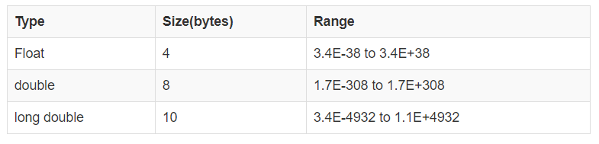
Primitive data types
2. Floating point data type: Floating types are used to store real numbers.

Slide 32
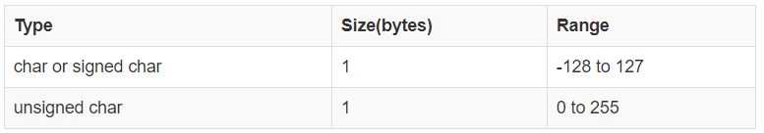
Primitive data types
3. Character type: Character types are used to store characters value.
4. Void type: void type means no value. This is usually used to specify the type of functions which returns nothing

Slide 33
Variable – Declaration and initialization

Slide 34
What is a Variable?
A variable is a name of the memory location which is used to store data given by the user.
Variable values can be changed, and it can be reused many times in the program.
Before going to use a variable in the program we must need to declare or define a variable with specified type.

Slide 35
Declaration and initialization
Variable declaration syntax:
data_type variable_name;
Example:
int a;
float area;
Variable initialization or definition:
data_type variable_name = value;
Example:
int a=10;

Slide 36
Rules for defining a variable
A variable can have alphabets, digits, and underscore.
A variable name must starts with the alphabet, and underscore but not with digits.
No whitespace or blank spaces are allowed within the variable name.
A variable name must not be any reserved word or keyword, e.g. int, float, etc.

Slide 37
Types of variables in C
There are many types of variable in C. Some of them are
1. local variable: The variable which is declare with in the function or block is called as local variable. It must be declared at the starting of a block and need to initialize local variable before it is used.
Example:
void hello( ) void main()
{ {
int a=10; hello();
printf(“%d”, a); }
}

Slide 38
Types of variables in C (cont..)
2. Global variable: A variable that is declared outside the function or block is known as global variable. Any function can change the value of the global variable and it is available to all the functions. It must be declared at the start of the block.
Example:
int value=20;//global variable
void fun() void main()
{ {
int x=10;//local variable fun();
printf(“%d,%d”, x,value); printf(“%d”, value);
} }

Slide 39
Types of variables in C (cont..)
3. Static variable: A variable that is declared with the static keyword is called static variable. It retains its value between multiple function calls.
Example:
void fun(){
int x=10;
static int y=10;
++x;
++y;
printf("\n%d,\t %d",x,y);
}
void main()
{
fun();
fun();
fun();
}
Output:
11, 11
11, 12
11, 13

Slide 40
Type conversions

Slide 41
What is Type conversion?
Typecasting is converting one data type into another one. It is also called as data conversion or type conversion.
'C' programming provides two types of type casting operations:
Implicit type casting
Explicit type casting

Slide 42
Implicit type casting
Implicit type casting means conversion of data types without losing its original meaning.
This type of typecasting is essential when you want to change data types without changing the significance of the values stored inside the variable.
During conversion, strict rules for type conversion are applied. If the operands are of two different data types, then an operand having lower data type is automatically converted into a higher data type.

Slide 43
Important Points about Implicit Casting
Implicit type of type conversion is also called as standard type conversion. We do not require any keyword or special statements in implicit type casting.
Converting from smaller data type into larger data type is also called as type promotion.
The implicit type conversion always happens with the compatible data types.

Slide 44
Implicit type conversion example
Converting short to int:
#include<stdio.h>
void main()
{
int a=10;
b=20;
float b;
b=a;
printf("%d\n",a);
printf("%d\n",b);
}

Slide 45
Explicit type casting
This conversion is done by user. This is also known as typecasting. Data type is converted into another data type forcefully by the user.
Syntax:
(type-name) expression;
Here,
The type name is the standard 'C' language data type.
An expression can be a constant, a variable or an actual expression.

Slide 46
Example:
#include<stdio.h>
void main()
{
double a = 1.2;
//int b = a; //Compiler will throw an error for this
float b = (float)a + 1;
printf("Value of a is %lf\n", a);
printf("Value of b is %f\n", b);
}
Output:
Value of a is 1.200000
Value of b is 2.200000

Slide 47
Flow of Control

Slide 48
Selection statements
Selection statements allow a program to test several conditions, and execute instructions based on which condition is true. That is why selection statements are also referred to as conditional statements.
There are two types of selection statements:
1. Two-way selection statements
2. Multi-way selection statements

Slide 49
Two-way selection
The two-way selection is the basic decision statement for computers. The decision is based on resolving a binary expression, and then executing a set of commands depending on whether the response was true or false.
Two way selection statements are:
Simple if statement
If – else statement
Nested if-else statement

Slide 50
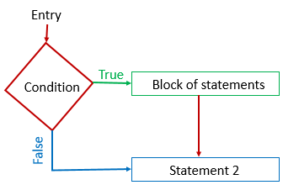
Simple if / if statement
The if statement is used to check some given condition and perform some operations depending upon the correctness of that condition.
It is mostly used in the scenario where we need to perform the different operations for the different conditions.
The syntax of the if statement is given below:
if(expression)
{
//statements
}

Slide 51
Example
#include<stdio.h>
void main()
{
int number;
printf("Enter a number:");
scanf("%d", &number);
if(number%2==0)
{
printf("%d is even number", number);
}
printf(“This is out of statements”);
}
Output:
Enter a number: 4
4 is even number
This is out of statements
Enter a number: 5
This is out of statements

Slide 52
If else statement
The if-else statement is used to perform two operations for a single condition.
The if-else statement is an extension to the if statement using which, we can perform two different operations, i.e., one is for the correctness of that condition, and the other is for the incorrectness of the condition.
Syntax is:
if(expression){
//code to be executed if condition is true
}
else{
//code to be executed if condition is false
}

Slide 53
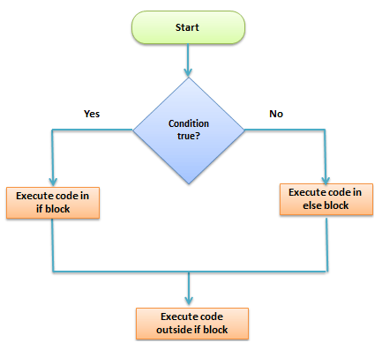
Example
#include<stdio.h>
Void main(){
int number;
printf("enter a number:");
scanf("%d", &number);
if(number%2==0){
printf("%d is even number", number);
}
else{
printf("%d is odd number", number);
}
}

Slide 54
Nested if-else
if(condition) {
//Nested if else inside the body of "if"
if(condition2) {
//Statements inside the body of nested "if“
}
else {
//Statements inside the body of nested "else“
}
}
else {
//Statements inside the body of "else"
}
When a series of decision is required, nested if-else is used. Nesting means using one if-else construct within another one.

Slide 55
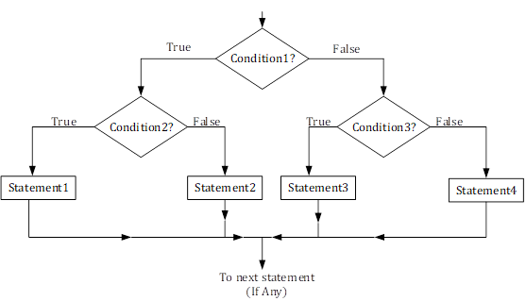

Slide 56
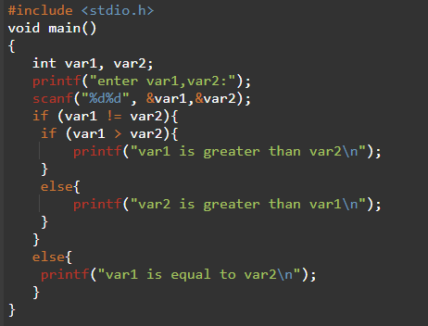
Example

Slide 57
Multi-way selection statements
A multi-way selection statement is used to execute at most ONE of the choices of a set of statements presented.
There are two multi-way selection statements:
else if ladder
Switch case

Slide 58
Else if ladder
It is used in the scenario where there are multiple cases to be performed for different conditions.
In if-else-if ladder statement, if a condition is true then the statements defined in the if block will be executed, otherwise if some other condition is true then the statements defined in the else-if block will be executed, at the last if none of the condition is true then the statements defined in the else block will be executed.

Slide 59
Else if ladder (syntax)
if(condition1){
//code to be executed if condition1 is true
}else if(condition2){
//code to be executed if condition2 is true
}
else if(condition3){
//code to be executed if condition3 is true
}
...
else{
//code to be executed if all the conditions are false
}

Slide 60
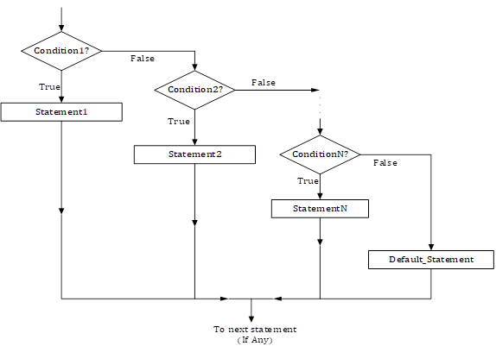

Slide 61
Example
#include<stdio.h>
Void main()
{
int a=7;
if(a<8)
{
printf(“a is less than 8”);
}else if(a==7)
{
printf(“ a is equal to 7”);
}
else if(a>6)
{
printf(“ a is greater than 6”);
}
else{
printf(“all conditions are false”);
}
}

Slide 62
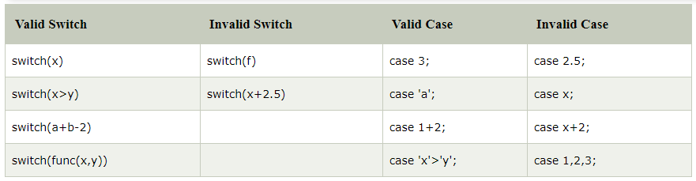
Switch case
The switch statement in C is an alternate to if-else-if ladder statement which allows us to execute multiple operations for the different possibilities values of a single variable called switch variable.
Here, We can define various statements in the multiple cases for the different values of a single variable.

Slide 63
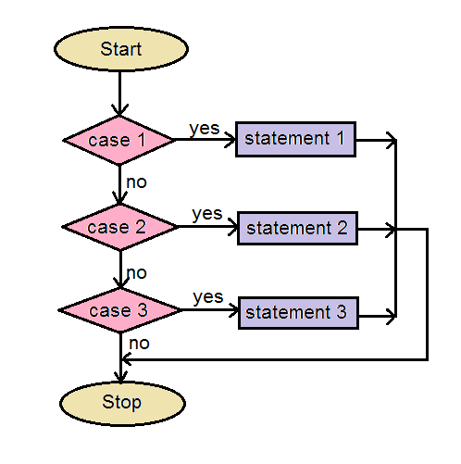
Syntax
switch(expression){
case value1:
//code to be executed;
break; //optional
case value2:
//code to be executed;
break; //optional
default:
code to be executed if all
cases are not matched;
}

Slide 64
Rules for switch statement
The switch expression must be of an integer or character type.
The case value must be an integer or character constant.
The case value can be used only inside the switch statement.
The break statement in switch case is not must. It is optional. If there is no break statement found in the case, all the cases will be executed present after the matched case. It is known as fall through the state of C switch statement.

Slide 65
#include<stdio.h>
void main()
{
int number;
printf("enter a number:");
scanf("%d", &number);
switch(number){
case 10:
printf("number is equals to 10");
break;
case 50:
printf("number is equal to 50");
case 100:
printf("number is equal to 100");
break;
default:
printf("number is not equal to 10, 50 or 100");
}
}

Slide 66
Repetition and Unconditional Control Statements

Slide 67
What is a loop?
A Loop executes the sequence of statements many times until the stated condition becomes false.
A loop consists of two parts, a body of a loop and a control statement.
The control statement is a combination of some conditions that direct the body of the loop to execute until the specified condition becomes false.
The purpose of the loop is to repeat the same code a number of times.

Slide 68
Types of loops
Depending upon the position of a control statement in a program, looping in C is classified into two types:
1. Entry controlled loop
2. Exit controlled loop
In an entry controlled loop, a condition is checked before executing the body of a loop. It is also called as a pre-checking loop.
Example: while loop, for loop
In an exit controlled loop, a condition is checked after executing the body of a loop. It is also called as a post-checking loop.
Example: do while loop

Slide 69
While loop
The while loop evaluates the test expression inside the parenthesis ().
If the test expression is true, statements inside the body of while loop are executed. Then, the test expression is evaluated again.
The process goes on until the test expression is evaluated to false.
If the test expression is false, the loop terminates (ends).

Slide 70
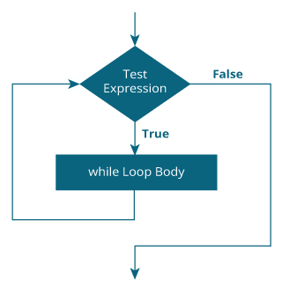
Flow chart of while loop
Syntax of while loop:
while (condition)
{
//statements;
increment / decrement;
}

Slide 71
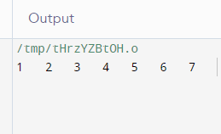
Example
#include<stdio.h>
Void main()
{
int i=1;
while(i<=7)
{
printf(“%d\t”, i);
i++;
}
}

Slide 72
Infinite loop
An infinite loop is a looping construct that does not terminate the loop and executes the loop forever. It is also called an indefinite loop or an endless loop. It either produces a continuous output or no output.
We can create an infinite loop through various loop structures.
for loop
while loop
do while loop

Slide 73
Examples
For loop:
#include <stdio.h>
void main()
{
for(;;)
{
printf("Hello world");
}
}
while loop:
#include <stdio.h>
void main() {
int i=1;
while(1)
{
i++;
printf(“%d”, i);
}
}
Do while loop:
#include <stdio.h>
void main() {
int i=1;
do
{
i++;
printf(“%d”, i);
}while(1);
}

Slide 74
for loop
Syntax of for loop:
for(initialization; condition; increment/decrement)
{
//statements;
}
The initialization of a value in for loop is performed only once.
After this it will check the condition, if it is false then for loop is terminated otherwise the statements inside the body of for loop are executed.
Finally, incrementation /decrementation part will be updated.

Slide 75
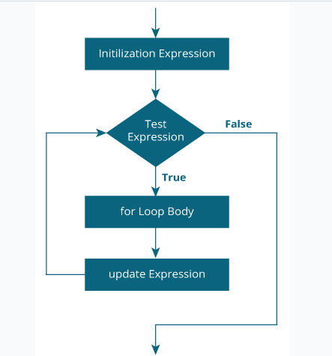
Flow chart of “for loop”

Slide 76
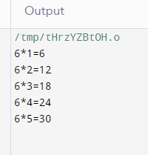
Example
#include<stdio.h>
void main()
{
int i, num=6;
for(i=1;i<=5;i++)
{
printf("%d*%d=%d\n", num, i,num*i);
}
}

Slide 77
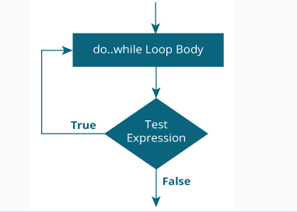
do while loop
In do-while, the body of a loop is always executed at least once. After the body is executed, then it checks the condition. If the condition is true, then it will again execute the body of a loop otherwise control is transferred out of the loop.
The syntax of do while loop is:
do
{
//statements;
increment/decrement;
}while(condition);

Slide 78
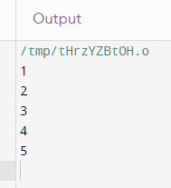
Example
#include<stdio.h>
void main()
{
int i=1;
do
{
printf("%d\n",i);
i++;
}while(i<=5);
}

Slide 79
Nested loops
The loop consists another loop is called nested loops. Any number of loops can be defined inside another loop, i.e., there is no restriction for defining any number of loops.
It has possibility to define any type of loop inside another loop; for example, we can define 'while' loop inside a 'for' loop.
Syntax for nested loops:
Outer_loop{
inner_loop{
//inner loop statements
}
//outer loop statements
}

Slide 80
Nested for loop
Syntax for nested for loop:
for (initialization; condition; increment/decrement)
{
for(initialization; condition; increment/decrement)
{
// inner loop statements.
}
// outer loop statements.
}

Slide 81
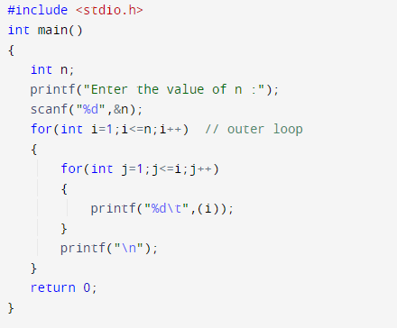
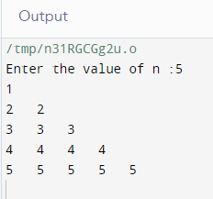
Example

Slide 82
Nested while loop
Syntax for nested while loop:
while(condition)
{
while(condition)
{
// inner loop statements.
}
// outer loop statements.
}

Slide 83
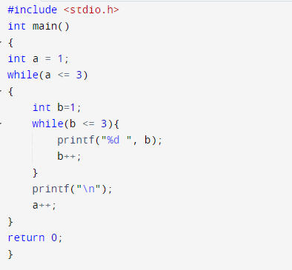
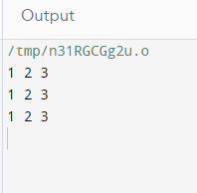
Example

Slide 84
Nested do while
Syntax for do while loop:
do
{
do
{
// inner loop statements.
}while(condition);
// outer loop statements.
}while(condition);

Slide 85
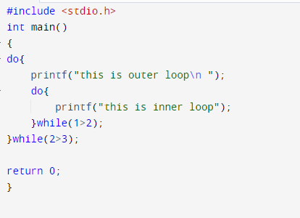
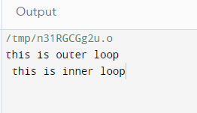
Example

Slide 86
Break statement in C
Break statement is used to break the process of a loop (while, do while and for) and switch case.
Syntax: break;
Break statement in while loop: Break statement in for loop:
while(condition) for(initial; condition; inc/dec)
{ {
if(condition) if(condition)
{ {
break; break;
} }
} }

Slide 87
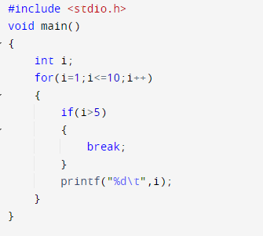
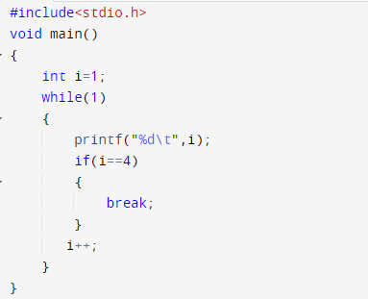
Examples

Slide 88
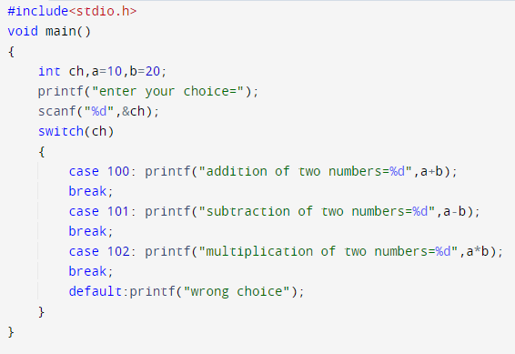
Examples

Slide 89
Continue statement in C
The continue statement is used inside loops. When a continue statement is encountered inside a loop, control jumps to the beginning of the loop for next iteration, skipping the execution of statements inside the body of loop for the current iteration.
Syntax:
continue;

Slide 90
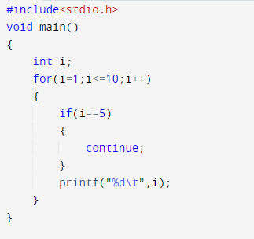
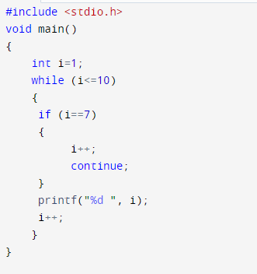
Example

Slide 91
Goto statement in C
The goto statement allows us to transfer control of the program to the specified label.
Syntax of goto Statement:
goto label;
//statements;
label:
// statement;
The label is an identifier. When the goto statement is encountered, the control of the program jumps to label: and starts executing the code.

Slide 92
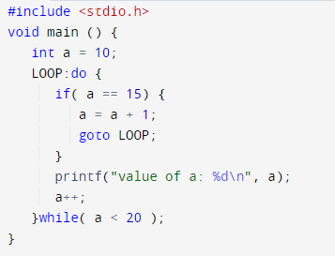
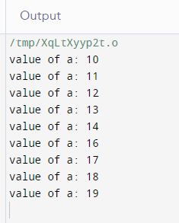
Example

Slide 93
Thank You

